Slide 1

A study on developing a hybrid recommender system for Telecommunication Industry in Sri Lanka
Chiran Hewawitharana IM/2016/046
Supervised By: Dr. Chathura Rajapaksha
Co-supervised By: Mr. Dinesh Asanka

Slide 2
Content
Background of the research
Research problem
Scope of the research
Literature review
Proposed solution
Proposed methodology
Progress so far - SLT Project

Slide 3

Research Problem

Slide 4
Background of the Research
The Telecommunication Industry has become the center for digital growth in Sri Lanka.
10.9 million (34 per 100 people) internet users and 30.41 million mobile connections (1499 per 1000 people), equivalent to 141.7% of the total population [Central Bank, 2020]
SLT Telecom alone is 9 million subscribers with a growing 91,119 million revenue by 2020. [Sri Lanka Telecom PLC, 2020]
Recommender Systems are quiet popular and enhancing the business profits in Retail industries. But no considerable involvement found in Telecommunication Industry in Sri Lankan context.
Telecommunication data are highly asynchronous and significantly different compared to retail and other industries.

Slide 5
Research Problem
Lack of research for a Recommender System for Telecommunication Industry in Sri Lankan Context.
None has addressed recommending fixed-line services.
High availability of Telecom service providers and service packages, subscriber churn has increased.
Some services may pass unobserved. If they were recommended when needed, subscriber may continue with the career.
Loyal subscribers need to be identified and rewarded with cross-selling and up-selling offers.

Slide 6
Research Problem
To address this dynamic market and high competition, a traditional recommender system won’t be enough.
Issues with Collaborative Filtering approach in a dynamic context (cold-start etc.)
User-service interactions, and demographics content alone won’t give accurate recommendations.
Awareness of Context (Contextual pre-filtering approach) is critical.
Recommendation need to be offered to the more beneficial subscriber groups.
Subscriber segmentation, identifying and prioritizing target subscriber groups, is crucial for enhancing the business value of recommendations offered.

Slide 7

Research Problem : Scope
Artificial Intelligence
DL - Neural Networks NLP Text Mining
Fixed-Line Voice Calls BroadBand Cable TV
Hybrid Recommender (CF + CBF)
Context- aware
Telecom Industry
Recommender Systems

Slide 8
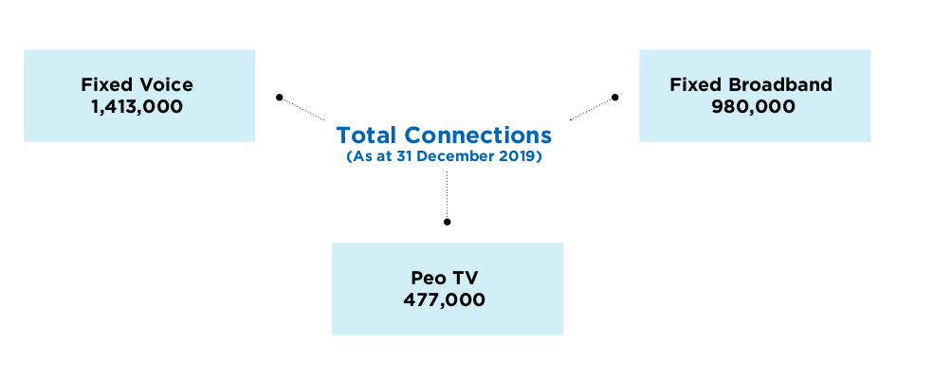
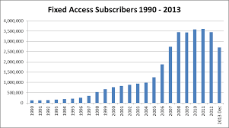
Research Problem : Justification
Due to high competition, huge variety of services available, Sri Lanka Telecom (SLT) requires a recommender system to recommend services to its beneficial subscribers to increase satisfaction, reduce churn and gain profits.
There is a dearth of studies done in Sri Lanka in particular telecom sector to implement a recommender system. (Non targeting fixed-line subscribers)
Acquiring new customers has become multiple times more expensive than retaining a customer. [Chen C., 2016]
According to [Soft et. al., 2017], as telecommunication services continuously providing different choices to the end user, leading some services to pass unobserved even if useful.

Slide 9
Research Gap
There is a dearth of studies done in Sri Lanka in particular telecom sector to implement a recommender system.
Even though recommender systems are proposed and implemented relevant to the domain, consideration of the context (contextual pre-filtering approach) is less (or not) considered.
Requirement of an accurate personalized recommender engine to recommend fixed-line services to subscribers, has arised to meet the company’s business strategies.
This study fills two gaps (practise gap and empirical gap)

Slide 10
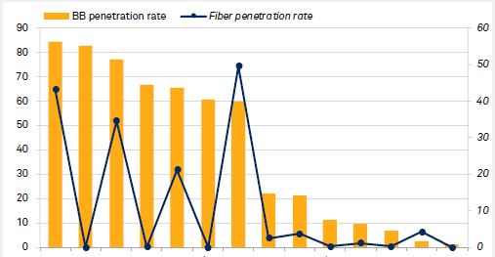
Literature Review

Slide 11
01. Recommender System - theories and applications
Reference | Related findings and suggestions
[Seyednezhad et. al., 2018] | Main four methods: Demographic filtering, content-based filtering, collaborative filtering and hybrid methods CF: Methods of extracting user interactions for a recommendation: Explicit/ Implicit CBF: make recommendations based on the description of the items. Three parts: content analyzer, profile learner and filtering component. CBF techniques: Keyword based vector space model CF techniques: Cosine similarities, KNN - Neighbourhood approach, latent factor model, Challenges: cold-start problem, multi armed bandit

Slide 12
01. Recommender System - theories and applications
Reference | Related findings and suggestions
[Yousef et. al., 2018] [Aggarwal CC, 2016] | Hybrid recommenders: Combination of CF, CBF and Contextual information. Memory based recommenders: Use of User-item rating matrix, depend on past data. Model based recommenders: generates a model that learns from the information of user-item ratings and recommends new items. Hybrid approach: Either CBF-> multi-level CF or CF -> multiclass CBF (user ratings are used as a user feature) Evaluation methods: Quality of predication validated by MAE (Mean Absolute error), RSME (Root Mean square error) and coverage

Slide 13
02. Recommender Systems in Telecommunication Industry
Reference | Related findings and suggestions
[Soft et. al., 2017] | Importance of recommendation: lose their revenues because of customers switching from one provider to another in search of cheap affordable high-quality products and services. Lack of a proper understanding of the both current and future(predictive) customer base, and their(predictive) requirements lead to customer churn and revenue lost. Context features (independent variables) identified: User activity context, time, location, User-item correlation, User satisfaction/opinions (Likert scale values) having a reduced set of items is more important that having one item recommended.

Slide 14
02. Recommender Systems in Telecommunication Industry
Reference | Related findings and suggestions
[Zui Zhang et. al., 2013] [Yu,Jian et. al., 2011] | Suggested approach: to collect new customer information, gather similar existing customer data (purchase records, usage history) and to collect replated product data. The main characteristics of telcom data is here there could be millions of users and relatively few services. Unlike enterprise applications which are usually invoked synchronously, telecom applications are always invoked asynchronously. Proposed algorithms: Generic user/ item based/ item-user/ slope one ItemAverageRecommender: except that estimated preferences are adjusted for the Users' average preference value. TreeClustering approach

Slide 15
03. Telecom Big Data Analytics
Reference | Related findings and suggestions
[Bursha et. al., 2019] [Chen C., 2016] | With the advancement and of big data technologies, operators are now able to collect more nearly complete data about a user’s experience and behavior. Challenges: capabilities of uncovering insights from large volume of datasets, Velocity and Variety. Telcom framework contains three horizontal layers – resource, service, and customer, spanning across two vertical perspectives – infrastructure & product and operations. The telecom data may include, user locations, CRM and call center logs, usage, network performance, subscriber plans, and demography,which may associated with a set of service KPIs (S-KPIs)

Slide 16
04. Context-awareness for recommender systems
Reference | Related findings and suggestions
[Adomavicius et. al., 2011] | Context adds an additional another dimension to the user-item data model of recommender system and can be utilized in different ways during CBF or CF processes. Representational and interactional context. Contextual factors to consider: Time context, location purchasing purpose etc. Knowledge of contextual factors in a recommender system: full or partially observable, unobservable. Contextual pre-filtering: Context is derived and used prior to the modeling to select the suitable 2D recommender (user x rating) Exact content can be too wide or narrow.

Slide 17
04. Context-awareness for recommender systems
Reference | Related findings and suggestions
[Sundermann et. al., 2019] [Bahramian et. al., 2017] | Context: Physical context, social context, interaction media context and model context. There are increasing efforts to incorporate the rich information embedded in user’s reviews/texts into the recommender systems. Challenges: difficulty in the acquisition of contextual information. There is a lack of automatic methods for extracting this type of information. User opinions: overall opinions, aspect opinions Interest of a user on an item is usually measured by a rating which can be obtained either explicitly or implicitly.: Numeric, Ordinal, Binary, Unary

Slide 18
05. Deep Learning Recommender Systems
Reference | Related findings and suggestions
[Covington et. al., 2016] [Xiangnan et. at., 2017] | Embedded features to an extended matrix factorization model, which answers the cold-start problem in collaborative filtering, with more precise and accurate recommendations. Introducing Neural Collaborative Filtering. Consideration of data: variety, freshness, and noise Suggest hybrid recommender model with two deep learning models, extended matrix factorization model (with user context as an additional inputs) for Collaborative filtering called as “candidate generation”. It returns a shortlisted set of recommendations which then filtered out by Content based recommender model to derive the final set of personalized recommendations.

Slide 19
Research Purpose
The purpose of the research is to implement a hybrid-recommender system, which is aware to the user content, interactions and other contextual factors, and able to provide accurate recommendations on fixed-line telecom services offered by the desired company, to its current subscribers.
Research Approach: Mixed approach (Qualitative, Quantitative)

Slide 20
Research Questions
How do we analyze the relationship between telecommunication subscribers and telecommunication services (packages)?
What are the challenges telecommunication companies face that lead to high revenue loss, churn and bad customer experience?
What are the factors affecting in recommending fixed-line telecom services to a subscriber ? (Voice calls, Broadband internet, cableTV)
What are the identifiable customer segments and how to determine which services/ packages are most applicable/ profitable targeting these segmented groups
How to provide accurate recommendations considering user interactions and contextual information?

Slide 21
Research Objectives
To analyze the relationship between telecommunication subscribers and telecommunication services (packages)
To identify the challenges telecommunication companies face that lead to high revenue loss, churn and bad customer experience.
To identify the factors affecting in recommending fixed-line telecom services to a subscriber (Voice calls, Broadband internet, cableTV).
To identify beneficial subscriber segments and determine which services/ packages are most applicable/ profitable targeting these segmented groups
To provide accurate recommendations considering user interactions and contextual information.
To suggest strategies to enhance cross-selling and up-selling of fixed-line telecom services among subscribers through accurate recommendations.

Slide 22

Proposed Solution

Slide 23
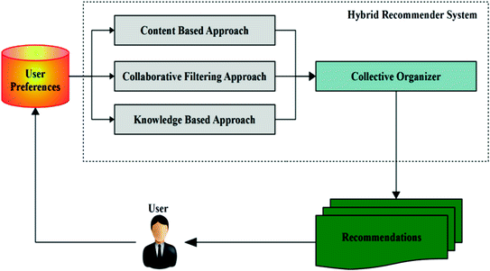
Proposed Solution
Developing a context-aware hybrid recommender system to recommend telecommunication services (Fixed-line services) to its subscriber segments, targeting cross-selling and up-selling.
Gathering and extracting contextual features, taken as inputs to the recommender system, in order to provide more accurate recommendations.
Subscriber segmentation using uplift-modeling technique - to identify and prioritize beneficial subscriber groups.

Slide 24
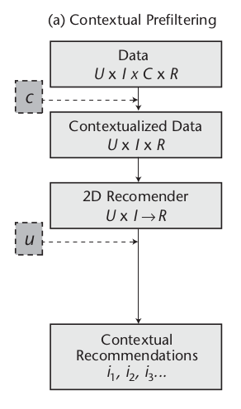
Proposed Solution
Why Context is important?
Telecommunication services data and user behaviours are dynamic and asynchronous.
Considering the User-Service interactions, demographic content won’t be enough for accurate predictions.
Contextual pre-filtering:
Contextual features, taken as inputs to the model at the time of training.
Context considered:
Business rules
Derived user preferences
Usage depend on Timeframes/ Locations
User reviews and sentiment on services
U - User data C - Context
I - Interactions R - recommendation

Slide 25
Proposed Methodology
A systematic review of literature will be conducted on building a recommender system for telecommunication Industry.
Stage 1
Stage 2
Stage 3
Stage 4
Data Collection
Data Analysis and Feature Engineering
Development of predictive recommender models
Testing, Validation and Integration as an end- user service
Structured Data
* Service Usage: Ratings * User demographics * conducting a survey
Unstructured Data
* CRM logs - inquiries/complaints * Other user reviews
Comparing available recommender techniques
Developing deep learning hybrid recommender model(s)
Testing and validating the accuracy of predicted results
Integrating predicted results to a web-based system to be consumed by end-users
Developing User Profile
Developing Service/package profiles
Analysis of unstructured text data using text mining, NLP
Extracting contextual information for pre-filtering

Slide 26
Proposed Methodology cont’d.
Data Gathering
Data pre-processing
User Demographic content (U)
Usage Ratings (I)
Structured
Ex: Usage and demographics data
Unstructured
Ex: reviews/ CRM logs
Text Mining
NLP
Feature Engineering
Telcom Services/ Packages
Contextual features (C)
Subscriber Segmentation
Provide Recommendations
cross-selling
Clustering (Uplift Modeling)
Hybrid Recommender system CF -> CBF ( +Context(C) )
Recommend Services/ Packages
Identifying and prioritizing subscriber segments for recommendations
up-selling
Recommend Similar Users’ content

Slide 27
Proposed Methodology cont’d.
Hybrid Recommender system (ANN)
User & Services content
Segmented subscriber groups
Users (U)
CF Model
( U x I -> R )
Selected set of recommendations
CBF Model
Interactions (I)
Context (C)
Personalized Recommendations
Similar Users
cross-selling
up-selling

Slide 28
Proposed Solution : Approach
Solution Approach:
Deductive : Aims to prove existing theories within formulated hypothesis
Predictive: Provide predicted recommendations on past context
Proposed Technologies:
Data pre-processing : Python, Pandas, SQL
Descriptive analysis: Pandas, numpy, seaborn, matplotlib, plotty
Text mining and feature extraction: NLP using Python, NLTK, (Gensim, spaCy)
Predicting recommendations: Deep-Learning- ANN using Python, Tensorflow, Keras
Uplift Modeling - Python pylift

Slide 29
Progress so far : SLT Project
Descriptive analysis on service usage datasets (VOICE/BB/PEO TV)
Analysis on ”Product State Changes” dataset
Building user profile (usage ranks, user location, and interested packages)
To Do:
Service/ Package profile
Gather and extract contextual data : text analysis
Implementation of feasible recommender models
Resolve possible problems relevant to recommendation classification ( Cold start/ Multi-armed bandit)

Slide 30

Demonstration

Slide 31
References
[Seyednezhad et. al, 2018] Seyednezhad, s. M. Mahdi & Cozart, Kailey & Bowllan, John & Smith, Anthony. (2018). A Review on Recommendation Systems: Context-aware to Social-based.
[Bursha et. al., 2019] Bushra Ramzan, Imran Sarwar Bajwa, Noreen Jamil, Riaz Ul Amin, Shabana Ramzan, Farhan Mirza, Nadeem Sarwar, "An Intelligent Data Analysis for Recommendation Systems Using Machine Learning", Scientific Programming, vol. 2019, Article ID 5941096, 20, 2019.
[Chen C., 2016] Chen, C. (2016). Use cases and challenges in telecom big data analytics. APSIPA Transactions on Signal and Information Processing, 5, E19, 2016.
[Ivens et.al., 2018] Ivens Portugal, Paulo Alencar, and Donald Cowan. The use of machine learning algorithms in recommender systems: A systematic review. ExpertSystems with Applications 97 (2018), 205–227, 2018.

Slide 32
References
[Ahmed et. al., 2019] Ahmed, A.A.Q., Maheswari, D. An enhanced ensemble classifier for telecom churn prediction using cost based uplift modelling. Int. j. inf. tecnol. 11, 381–391, 2019.
[Yousef et. al., 2018] Yousef Kilani, Ahmed Fawzi Otoom, Ayoub Alsarhan, Manal Almaayah, A genetic algorithms-based hybrid recommender system of matrix factorization and neighborhood-based techniques, Journal of Computational Science, Volume 28, Pages 78-93, ISSN 1877-7503, 2018.
[Aggarwal CC, 2016] Aggarwal CC (2016) Ensemble-based and hybrid recommender systems. In: Recommender systems, Springer International Publishing Switzerland, pp 199–224, 2016
[Sundermann et. al., 2019] Sundermann, C.; Domingues, M.; Sinoara, R.; Marcacini, R.; Rezende, S. Using Opinion Mining in Context-Aware Recommender Systems: A Systematic Review.Information 2019, 10, 42, 2019.
[Zui Zhang et. al., 2013] Zui Zhang, Hua Lin, Kun Liu, Dianshuang Wu, Guangquan Zhang, Jie Lu, A hybrid fuzzy-based personalized recommender system for telecom products/services, Information Sciences, Volume 235, Pages 117-129, ISSN 0020-0255,, 2013.

Slide 33
References
[Adomavicius et. al., 2011] Adomavicius, G., Mobasher, B., Ricci, F., & Tuzhilin, A. (2011). Context-Aware Recommender Systems. AI Magazine, 32(3), 67-80.
[Yu,Jian et. al., 2011] Yu, Jian & Falcarin, Paolo & Vetro, Antonio. (2011). A Recommender System for Telecom Users: Experimental Evaluation of Recommendation Algorithms. Proceedings of 2011, 10th IEEE International Conference on Cybernetic Intelligent Systems, CIS 2011. 81-85. 10.1109/CIS.2011.6169139.
[Bahramian et. al., 2017] Bahramian, Zahra & Abbaspour, Rahim & Claramunt, Christophe. (2017). A Cold Start Context-Aware Recommender System for Tour Planning Using Artificial Neural Network and Case Based Reasoning. Mobile Information Systems. 2017. 1-18. 10.1155/2017/9364903.
[Covington et. al., 2016] Covington, Paul, J. Adams and Emre Sargin. “Deep Neural Networks for YouTube Recommendations.” Proceedings of the 10th ACM Conference on Recommender Systems (2016): n. Pag.
[Xiangnan et. at., 2017] He, Xiangnan & Liao, Lizi & Zhang, Hanwang. (2017). Neural Collaborative Filtering. Proceedings of the 26th International Conference on World Wide Web.

Slide 34
Thank You

